Slide 1
Lecture 01
Introduction

Slide 2
BASIC INFORMATION
Course Title | : INFORMATION SYSTEMS ANALYSIS AND DESIGN
Course Code | : 12140412
Credit Hours | : 03
Text Books | :SYSTEMS ANALYSIS AND DESIGN IN A CHANGING WORLD ; 6TH EDITION

Slide 3
TOPICS TO BE COVERED
No. | Chapter 01 | From Beginning to End: An Overview of Systems Analysis and Design
01 | Chapter 02 | Investigating System Requirements
02 | Chapter 03 | Use Cases
03 | Chapter 04 | Domain Modeling
04 | Chapter 05 | Extending the Requirements Models
05 | Chapter 06 | Essentials of Design and the Design Activities
06 | Chapter 07 | Designing the User and System Interfaces
07 | Chapter 10 | Object-Oriented Design: Principles
08 | Chapter 11 | Object-Oriented Design: Use Case Realizations
09 | Chapter 13 | Making the System Operational

Slide 4
SE vs ISA&D
Software Engineering (SE) is typically a stand-alone program in the computer science area, while Systems Analysis & Design (SA&D) is a course typically taught in a Management Information Systems (MIS) program.
Software engineering is focused on developing a software and SA&D is focused on developing an information system.
Both SE and SA&D are focused on the phased approach of developing a software or system, commonly known as Software or Systems Development Life Cycle (SDLC). The various approaches of SDLC: waterfall, iterative, spiral, Agile, and others are applicable to both.

Slide 5
From Beginning to End: An Overview of Systems Analysis and Design
Chapter 01

Slide 6
Introduction
Computer Application (app):
Is a computer software program that executes on a computing device to carry out a specific function or set of related functions.
Information System:
Is a set of interrelated computer components that collects, processes, stores (usually in a database), and provides as output the information needed to complete business tasks.
Application usually refers to only the computer software involved, whereas an information system may include the software, the database, and even the related manual processes.

Slide 7
Introduction [Con.]
Systems analysis consists of those activities that enable a person to understand and specify what the new system should accomplish.
Systems design consists of those activities that enable a person to describe in detail the system that solves the need.

Slide 8
Systems Development Life Cycle
Initial development of a new system is usually done as a project.
To manage a project with analysis, design, and other development activities, you need a project management framework to guide and coordinate the work of the project team.
The Systems Development Life Cycle (SDLC) identifies all the activities required to build, launch, and maintain an information system.

Slide 9
SDLC core processes
Identify the problem or need and obtain approval to proceed.
Plan and monitor the project
what to do, how to do it, and who does it.
Discover and understand the details of the problem or the need.
Design the system components that solve the problem or satisfy the need.
Build, test, and integrate system components.
Complete system tests and then deploy the solution.

Slide 10
Agile Development
Is an information systems development process that can be used to implement the six core process of SDLC.
Agile emphasizes flexibility to anticipate new requirements during development.

Slide 11
Iterative Development
An approach to system development in which the system is "grown" piece by piece through multiple iterations.
Core components are developed first and then additional components are added.
It is called “iterative” because the six core development processes are repeated over and over again to add additional functionality to the overall system.
In other words, there is one big project, which consists of many mini-projects, and the information system is grown piece by piece.

Slide 12
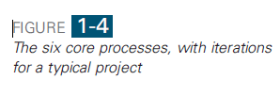
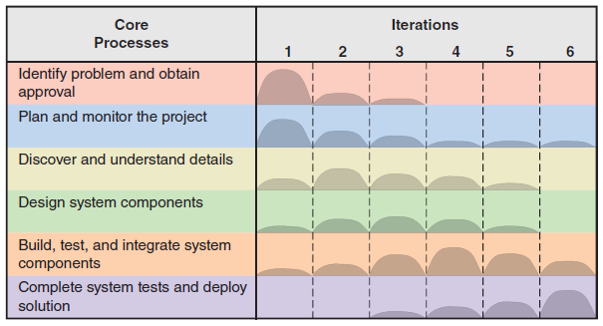

Slide 13
Iterative Development Benefits
Portions of the system can sometimes be deployed sooner.
If there are core functions that provide basic support, these can be deployed in an early iteration.
By taking a small portion and developing it first, many problems can be addressed early in the project.
By focusing on only a small portion, the requirements are fewer and easier to grasp and solve.
Developing a system in iterations makes the entire development process much more flexible and able to address new requirements throughout the project.

Slide 14
Iterative Development [Con.]
A key element of iterative development is choosing a part of the solution system that can be done in two to four weeks.
During one iteration, often all the core development processes are involved, including programming and system-wide testing, so the result is a part of the working system, even though it may only have a portion of the functionality that is ultimately required.

